Slide 1
Operation Remote Resupply PART 1
Model-View-ViewModel (MVVM) and Data Binding

Slide 2



Xamarin Forms
Xamarin
Xamarin Forms
iOS UI
Android UI
Windows UI
Shared UI (XAML)
Shared Logic (C#)
Shared Logic (C#)
Notes:
Xamarin allows developers to write cross-platform apps that run on iOS, Android, and Windows using logic that is written in C# and that is shared across platforms. Xamarin Forms does the same, but also allows shared UIs to be written in XAML. It is not uncommon for Xamarin Forms apps to share more than 90% of their code and user interface across platforms, minimizing the amount of per-platform code and UI required.

Slide 3
The Model-View-ViewModel (MVVM) Pattern
Can be used on all XAML platforms, including Xamarin Forms
Provides clean separation between controls in the user interface and the logic that drives them
Relies on data binding to bind properties of the view-model to controls in the view
View
View Model
Model
State and Operations
Notes:
MVVM is a popular pattern used in Xamarin Forms apps, and in all apps that use XAML for their user interfaces, including WPF apps and UWP apps. Xamarin Forms apps that use the MVVM pattern implement views in XAML. Controls declared in those views are data-bound to properties of the view-model, which sets between the view and the model. There is typically a 1-to-1 relationship between views and view-models, with each view-model purpose-built to serve a specific view. For example, if the view contains a form with four Entry controls for text input, the view-model will typically implement four string properties which can be bound to the Entry controls.

Slide 4
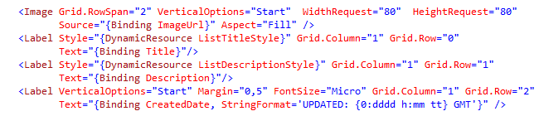


Data Binding
Assigns values to control properties by retrieving them from a data source
In MVVM, the data source is the view-model
One-way and two-way
Keeps UI in sync with the underlying data without closely coupling the two
The "glue" in MVVM
Notes:
RE: The "glue" in MVVM. Specifically, data binding binds properties in view-models to properties in views. Among other things, this allows you to write unit tests for the view-model independent of the view.

Slide 5
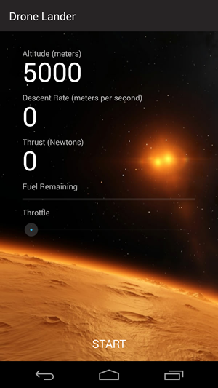
Binding a Label Control
<Label Text="{Binding Altitude}" />
public class MainViewModel : Common.ObservableBase
{
.
.
.
private double _altitude;
public double Altitude
{
get { return this._altitude; }
set { this.SetProperty(ref this._altitude, value); }
}
}
Notes:
This example, which comes from Lab 1, binds the view-model's Altitude property to a Label control that displays the altitude. For clarity, it omits the value converter used to format the output.

Slide 6
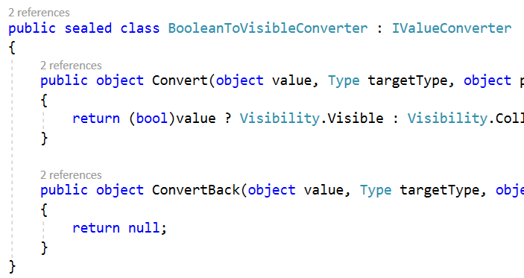
Value Converters
Modify data as it passes through the binding engine
Typically convert from one type to another
Sometimes used to format the data for display (without changing type)
Implement IValueConverter
{Binding Label,
Converter={StaticResource LabelConverter}}
Hello world
Hola mundo
Hej verden
Notes:
Converters are part of almost every XAML application. Their purpose is to convert one type to another when initializing properties of XAML elements declaratively. Common uses include converting strings to colors, converting nulls to Booleans, converting string arrays to strings for binding to Labels, and converting image paths to images. Value converters implement the IValueConverter interface, which contains two methods: Convert and ConvertBack. The latter is only used in two-way data binding scenarios.

Slide 7
Implementing a Value Converter
public class DecimalDisplayConverter : IValueConverter
{
public object Convert(object value, Type targetType,
object parameter, CultureInfo culture)
{
return ((double)value).ToString("F0");
}
public object ConvertBack(object value, Type targetType,
object parameter, CultureInfo culture)
{
throw new NotImplementedException();
}
}
Notes:
This value converter, which comes from Lab 1, formats decimal values for display as integer values. Without it, decimal values displayed for Altitude and other properties would include numbers to the right of the decimal point. Since this converter is only used in one-way data binding, the ConvertBack method simply throws a NotImplementedException.

Slide 8
Using a Value Converter
<ResourceDictionary>
<common:DecimalDisplayConverter x:Key="DecimalDisplayConverter"/
</ResourceDictionary>
.
.
.
<Label Text="{Binding Altitude,
Converter={StaticResource DecimalDisplayConverter}}" />
Notes:
This example, which comes from Lab 1, uses DecimalDisplayConverter to format the altitude readout displayed by a Label control. Specifically, it displays a decimal value as an integer value.

Slide 9
Commands
Separate business logic from UI elements that trigger that logic
Implement the ICommand interface
Exposed as view-model properties and bound to Command properties (or equivalent) of controls
UI Element
Command
Business Logic
Notes:
Commands encapsulate the code that implement actions that are triggered from the user interface. Rather than write a Clicked handler for buttons, for example, you can write a Command class whose Execute method performs an action when the button is clicked. Then you expose an instance of the Command class through the view-model and bind the button's Command property to the corresponding property in the view-model. This provides a clean separation between UI and business logic and prevents you from having to include click handlers in views.

Slide 10
Implementing a Command
public class StartCommand : ICommand
{
public event EventHandler CanExecuteChanged;
public bool CanExecute(object parameter)
{
// TODO: Return true or false
}
public void Execute(object parameter)
{
// TODO: Execute command
}
}
Notes:
The heart of a Command class is the Execute method, which is called to execute the command. The CanExecuteChanged event and CanExecute method allow the Command object to update the view based on the state of the application -- for example, enable a button when all input requirements are satisfied.

Slide 11
Binding a Command to a Button
<Button Text="Start" Command="{Binding StartCommand}" />
public class MainViewModel : Common.ObservableBase
{
.
.
.
public ICommand StartCommand
{
get
{
return new StartCommand();
}
}
}
Notes:
In this example, the view-model exposes a read-only property named StartCommand, which returns an instance of the command class StartCommand. The view binds the button's Command property to the view-model's StartCommand property, which results in the command being executed when the button is clicked.

Slide 12
Lab
Model-View-ViewModel (MVVM) and Data Binding

